Slide 1
Lecture 13: Iteration and For-Loops
for-loop and conditions, nested for-loop and condition
Kok-Seng Wong | 2021

Slide 2


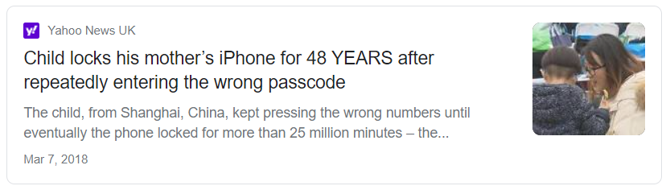
Motivation examples
[source]
[source]

Slide 3
Learning outcomes
Upon the completion of this lecture, students will be able to:
understand the concept of iteration.
describe the syntax for for-Loops.
use for-loops to remove repetition in code.
identify inner and outer loops in a nested for-loop.

Slide 4
iteration
A basic building block of all programs is to be able to repeat some code (over and over again).
Iteration: A repetitive execution (until a condition is met).
Example: Caesar Cipher (shift key = 8)
0 | 1 | 2 | 3 | 4 | 5
10
6 | 7 | 8 | 9
Plain:
m | i | c | k | e | y
m | o | u | s | e
Cipher:
u | q | k | s | m | g
u | w | c | a | m

Slide 5
For-loop flowchart
Entering for-loop for each item in sequence
Condition
(last item in the sequence?)
True
Statements after the for-loop
False
Body of the for-loop

Slide 6
For-loop
for-loop: used for iterating over a sequence (e.g., set, string, list, tuple, or dictionary).
Definite iteration: do something a fixed number (pre-determined) of times.
Processing each item in a sequence.
Execute a set of statements, once for each item in the sequence.

Slide 7
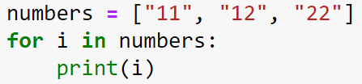
for-loop: processing lists
numbers[len(numbers)-1]
Entering for-loop for each item in numbers
Last element in the numbers?
loop sequence: numbers
loop variable: i
loop body: print(i)
True
Exit the for-loop
print(i)
False
Put next element in i

Slide 8
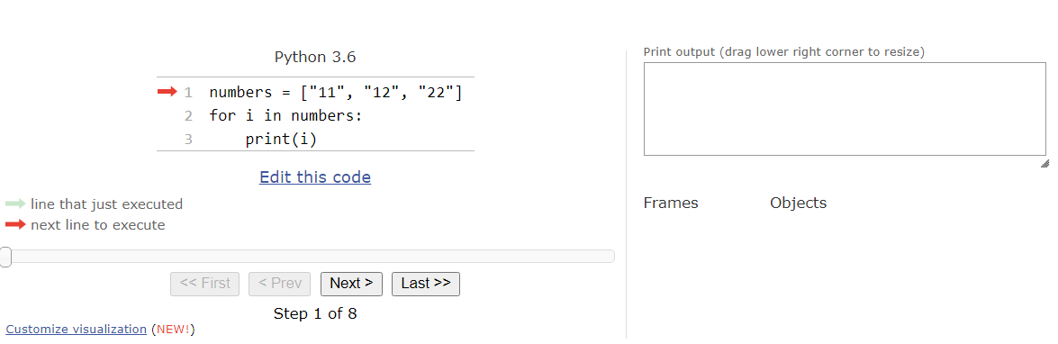
For-loop - python tutor
[Demo]

Slide 9
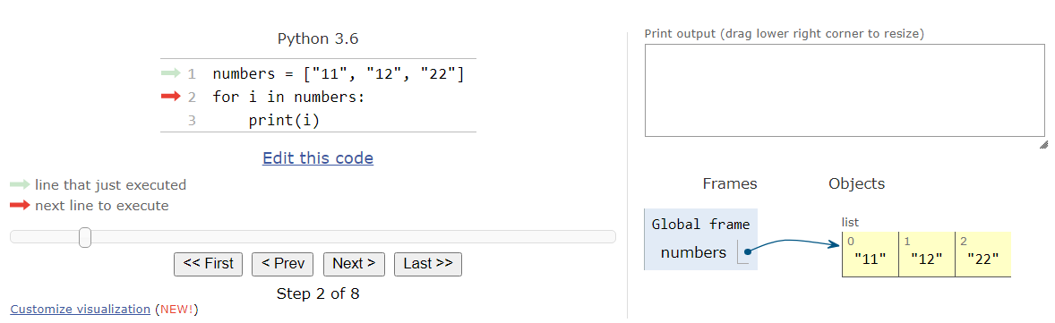
For-loop - python tutor

Slide 10
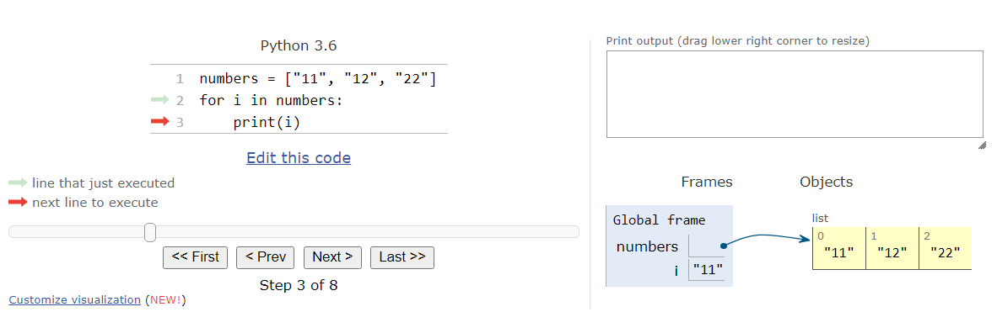
For-loop - python tutor

Slide 11

For-loop - python tutor

Slide 12

For-loop - python tutor

Slide 13
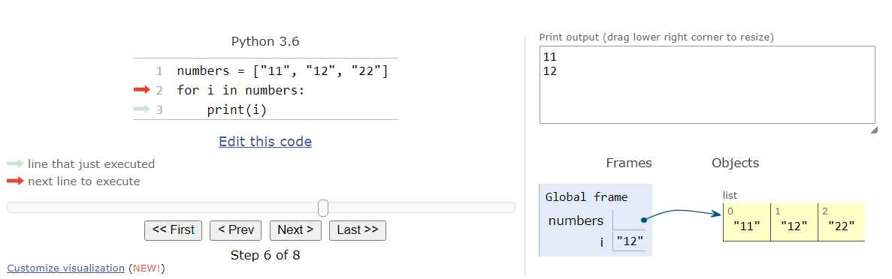
For-loop - python tutor

Slide 14

For-loop - python tutor

Slide 15
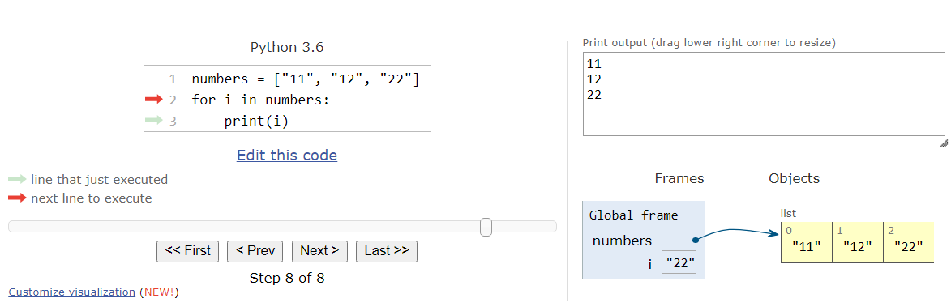
For-loop - python tutor

Slide 16
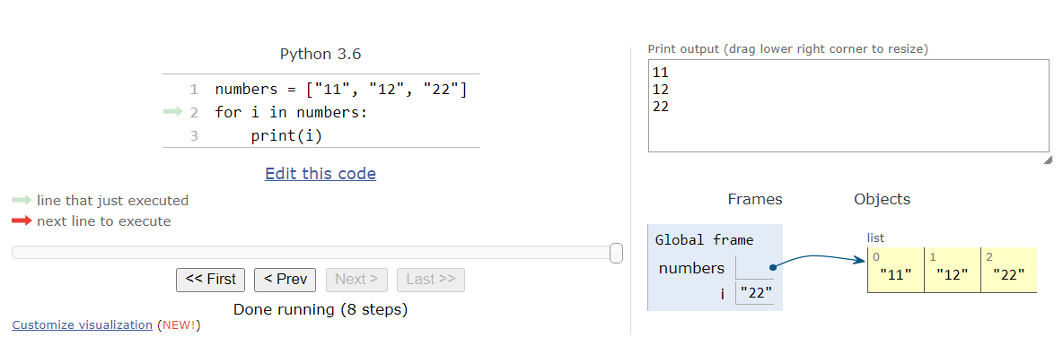
For-loop - python tutor

Slide 17
Create a list: using for loops
Empty list
Iterative condition
>>> my_list = []
>>> for i in range(1, 8):
>>> my_list.append(i * i)
>>> my_list
Added element into the list

Slide 18
Class practice
numbers = ["11", "12", "22"]
for i in numbers:
print( ? )
11 12 22

Slide 19
Class practice
x = ["a", "b", "c"]
for
Output 1 is a
Output 2 is b
Output 3 is c

Slide 20
Break and continue
Break and continue are two ways to modify the behavior of for-loop and while-loop (will be covered in Lecture 14).
Break: causes the program to exit a loop early.
Continue: causes the program to stop running code in a loop and start back at the top of the loop.
for-loop iteration:
statement 1
statement 2
break
...
statement n
statement(s)
for-loop iteration:
statement 1
statement 2
continue
...
statement n
statement(s)

Slide 21
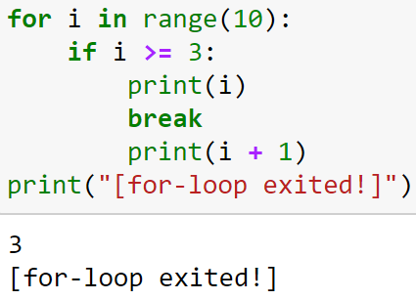
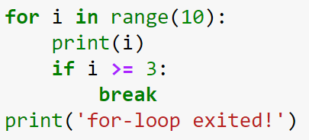
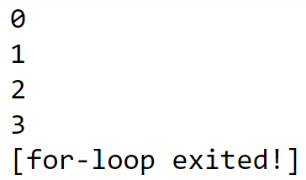
Break - Example
Break: causes the program to exit a loop early.

Slide 22
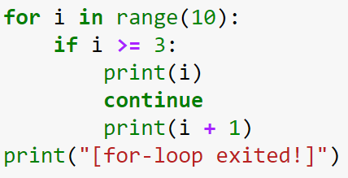
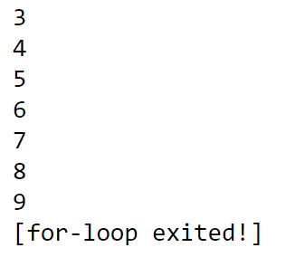
Continue - Example
Continue: causes the program to stop running code in a loop and start back at the top of the loop.

Slide 23

The Range function
do something n times:
generates the integer numbers between the given start integer to the stop integer
default values are start = 0 and step = 1
loop until value is stop - 1
range(start, stop, step)
Step = 1
using only one argument (stop)
0
0 | 1 | 2 | 3 | 4
5
output
start
stop

Slide 24
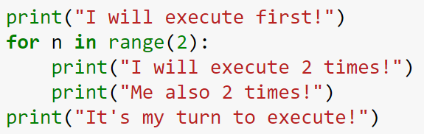
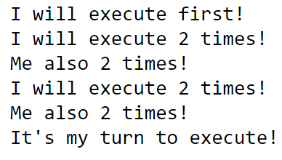
The Range function – example 1
I will execute first!
Loop variable
n=0
I will execute 2 times!
Me also 2 times!
n=1
Iteration
I will execute 2 times!
Me also 2 times!
It’s my turn to execute

Slide 25


tHe Range function – example 2
step = 1
using two arguments (start & stop)
2
2 | 3 | 4
5
output
start
stop
using all three arguments
Step = 2
2
2 | 3 | 4 | 5 | 6 | 7 | 8 | 9
10
output
start
stop

Slide 26

The Range function – example 3
Step = -3
using negative step
-10
-9 | -8 | -7 | -6 | -5 | -4 | -3 | -2
-2
stop
output
start
to use a negative step, start must be a larger value than stop

Slide 27
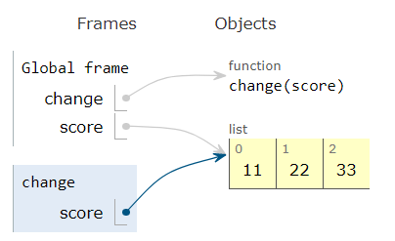
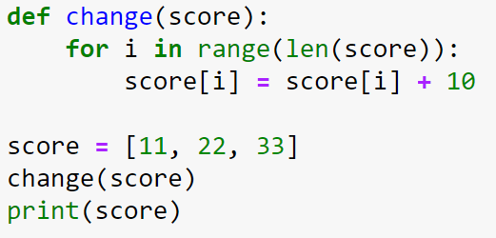
Changing the contents of a list
[Demo]
increase 10 for each element in the list

Slide 28
Class practice
Case 1:
for x in range(20, -10, -13):
print(x)
x = 10
Case 2:
for i in range(-2, -15, -5):
print(i)
i = 2
print(i)

Slide 29
summing the elements in range()
accumulator
Step = 2
sum = 0
for i in range(2, 10, 2):
sum += i
print(sum)
2
2 | 3 | 4 | 5 | 6 | 7 | 8 | 9
10
(0 | + | 2)
 |  | (2 | + | 4)
 |  |  |  | (6 | + | 6)
 |  |  |  |  |  | (12 | +
8)
20
start
stop

Slide 30
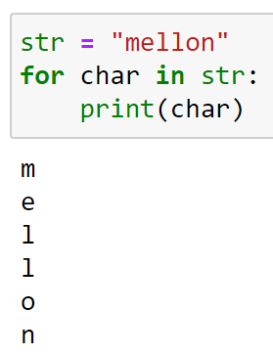
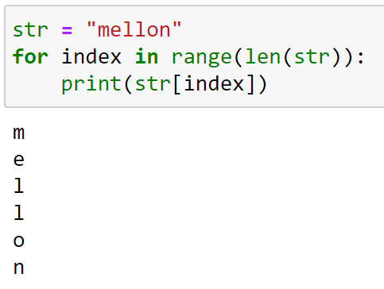
For-loop: processing strings
Straightforward technique:
Python range function:

Slide 31
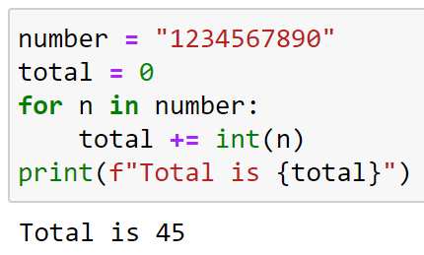
Summing elements in a string (1/2)
Straightforward technique:
Python range function:
Convert string to int

Slide 32
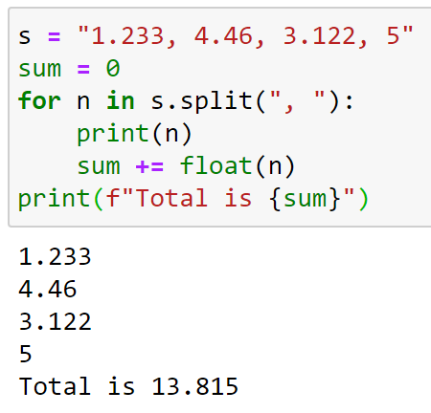
Summing elements in a string (2/2)
Straightforward technique:
Python range function:
Convert string to float

Slide 33
Class practice
str = "COVID"
for i in str:
print( ? )
C O v I D

Slide 34
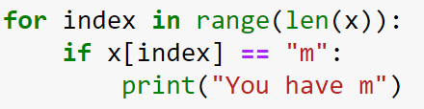
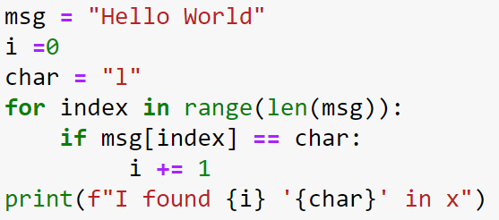
For-loop and conditions
Example 1
Example 2

Slide 35
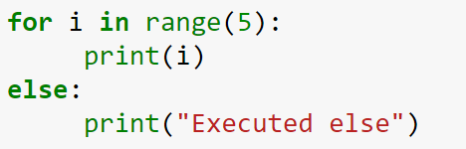
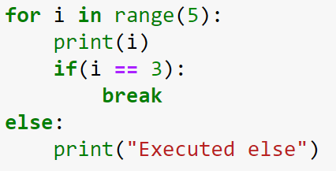
Using else Statement with for Loop
Python allows the use of else condition with for loops.
Example 1
Example 2

Slide 36
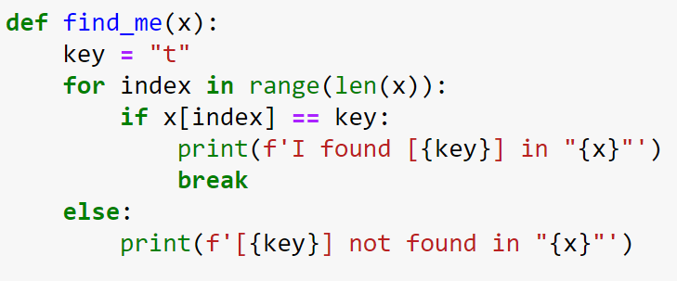
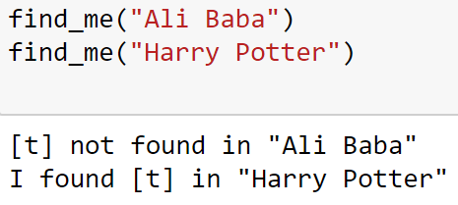
Class practice

Slide 37
Nested for-loop

Slide 38
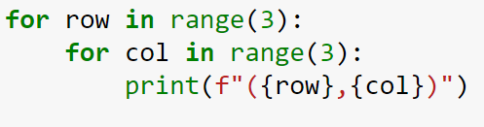
Nested for-loop
Nested loop: a loop inside a loop.
Print every position of a given tic-tac-toe board of 3x3
col
Steps:
Create a variable to hold the rows.
Create a second variable for columns.
Use a for-loop to iterate through rows.
Use the second for-loop to iterate through columns.
0 | 1 | 2
0
1
2
(0, 2)
row
(1, 2)
outer for-loop
inner for-loop

Slide 39
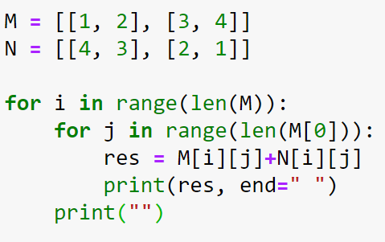


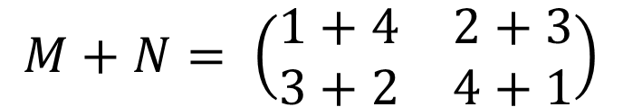

Nested for-loop Example 1
Find the sum of the following two matrices:
$$M= \left(\begin{matrix}1 & 2 \\ 3 & 4\end{matrix}\right)$$
$$N= \left(\begin{matrix}4 & 3 \\ 2 & 1\end{matrix}\right)$$
$$M+N= \left(\begin{matrix}1+4 & 2+3 \\ 3+2 & 4+1\end{matrix}\right)$$
$$= \left(\begin{matrix}5 & 5 \\ 5 & 5\end{matrix}\right)$$

Slide 40
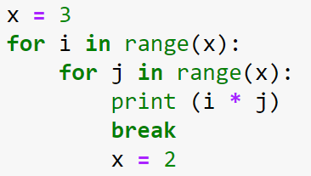
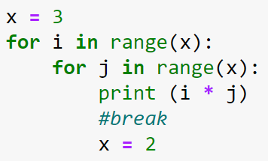
Nested for-loop Example 2
Case 1
Case 2
Changing the value of x inside the loop does not affect the number of iterations.

Slide 41
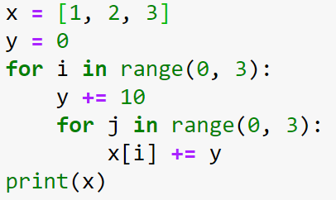
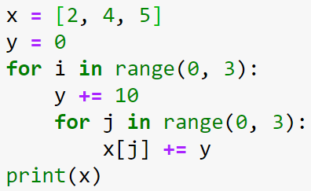
Nested for-loop Example 3
Case 1
Case 2

Slide 42
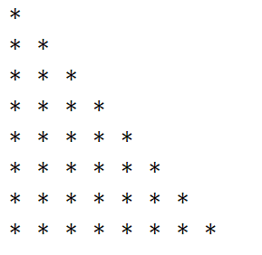
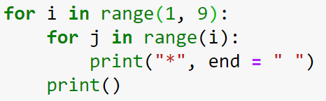
Nested for-loop Example 4

Slide 43
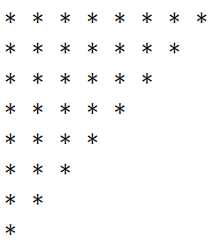
Class practice
Use a nested for-loop to print the output:

Slide 44
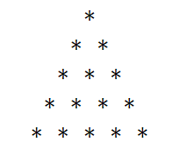
Class practice
Use a nested for-loop to print the output:

Slide 45
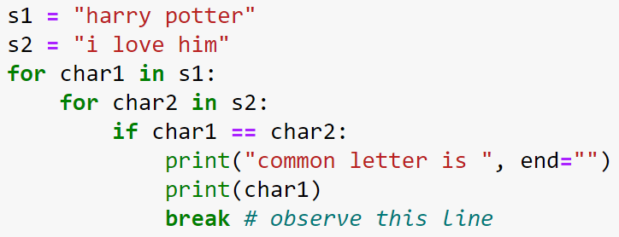
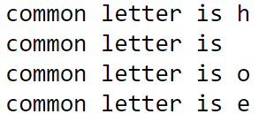
Nested for-loop and conditions

